Slide 1

Designing a Secure and Scalable AWS Cloud Infrastructure
Course: INFO2350 – Advanced Cloud Infrastructure Management
Group 6 Members: Gurkaran, Gulab, Vanshika, Parathna

Slide 2

Project Objective
Design and deploy a secure, scalable cloud solution on AWS
1
Host a web application with a backend database
2
Ensure public access only to the web app, while keeping the database private
3

Slide 3
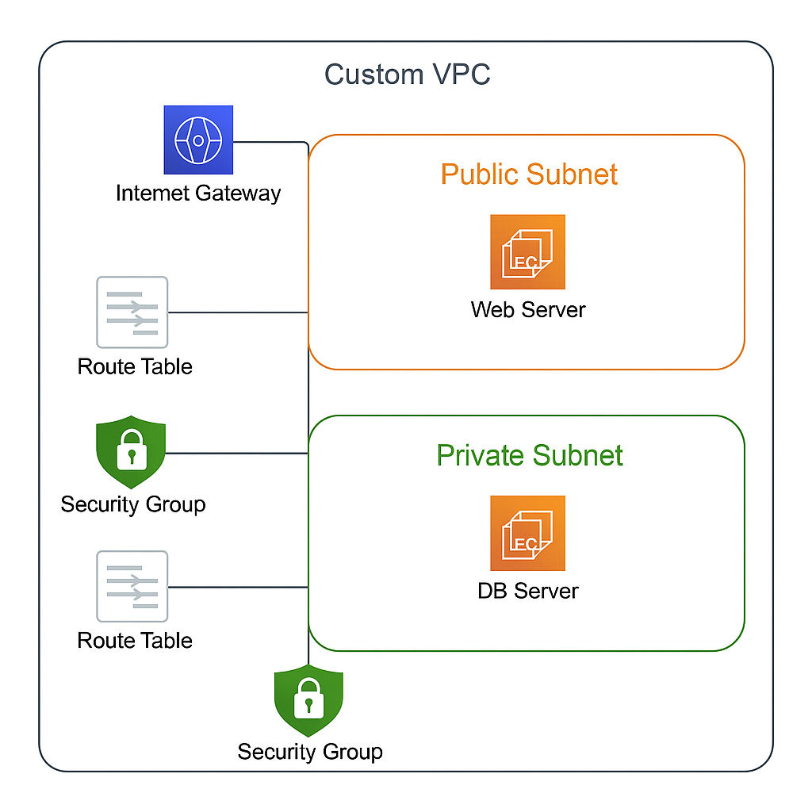
Architecture Diagram

Slide 4
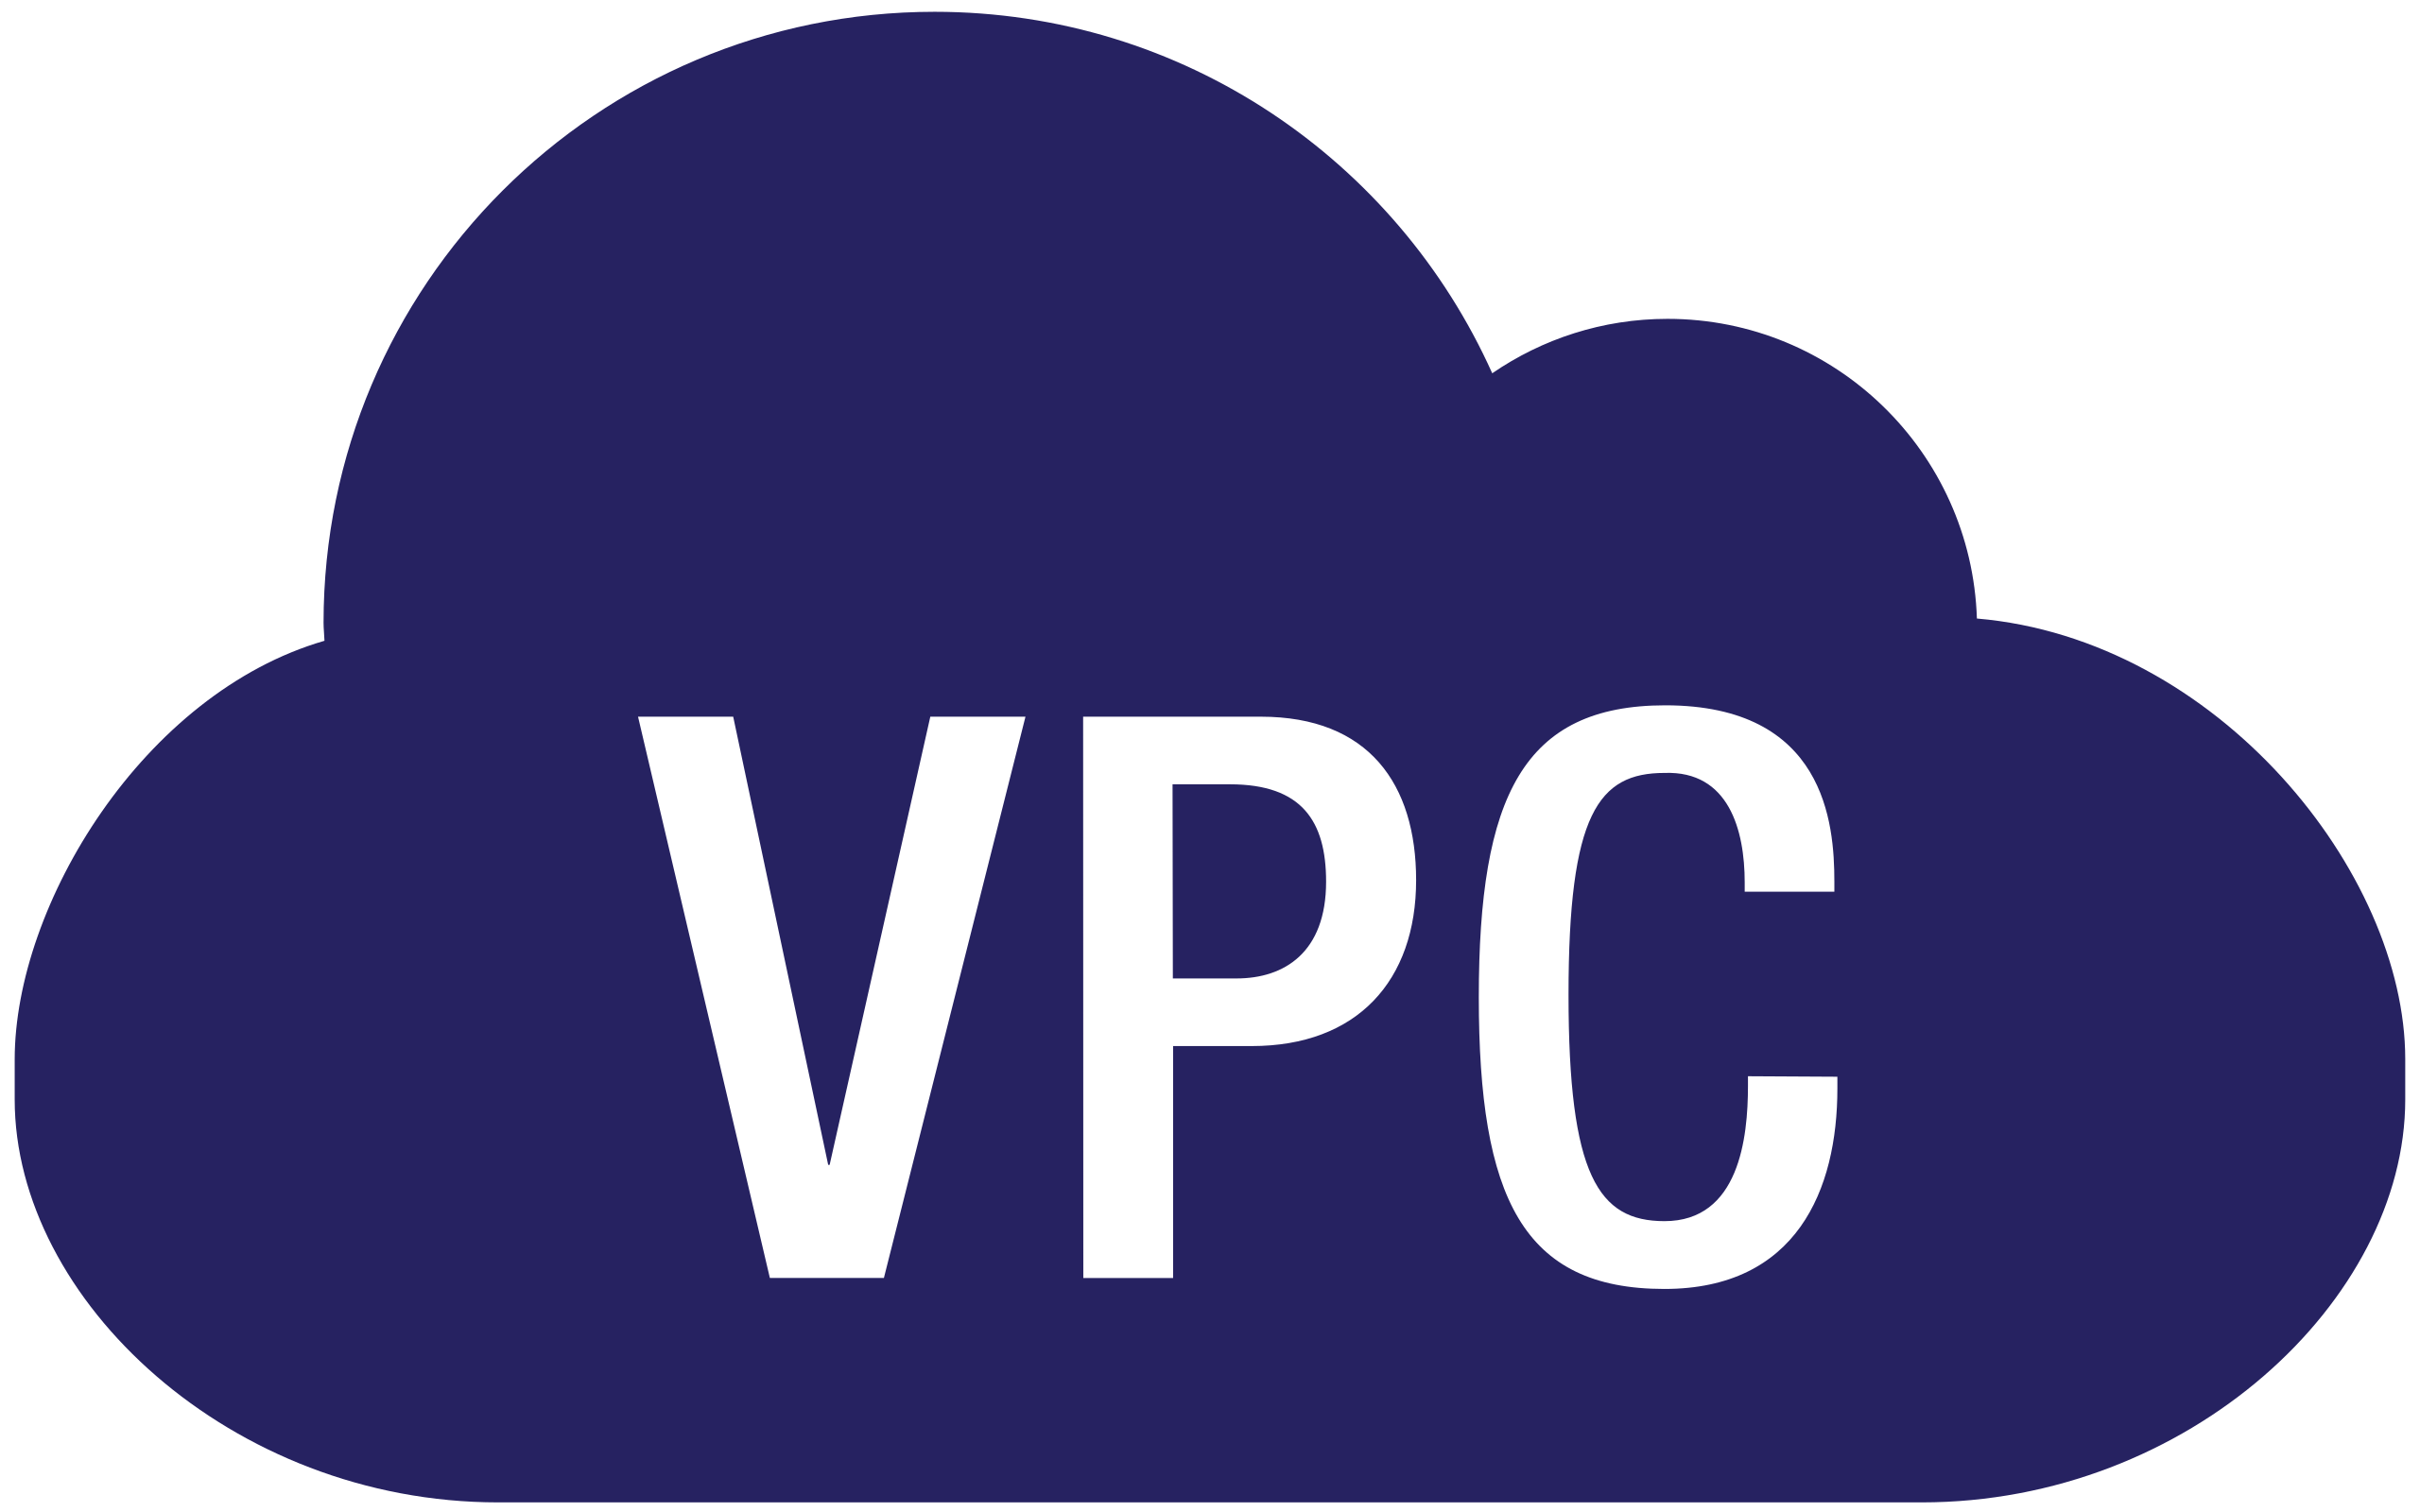
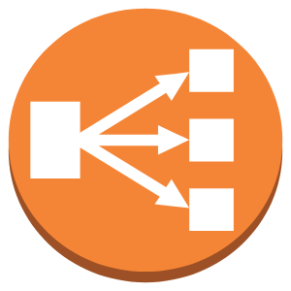
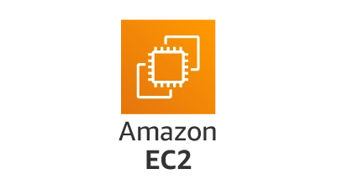
Implementation Steps
Created a custom VPC with two subnets
Deployed EC2 Web Server in Public Subnet
Deployed EC2 DB Server in Private Subnet
Configured Route Tables and Internet Gateway
Set up Security Groups for Web and DB servers

Slide 5
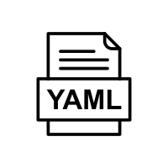
Automation using CloudFormation (Part 3)
Created CloudFormation Template (YAML)
Resources automated:
VPC, Subnets, IGW, Route Tables
EC2 Instances, Security Groups
Benefits:
Quick setup in future
Consistent, repeatable deployments

Slide 6
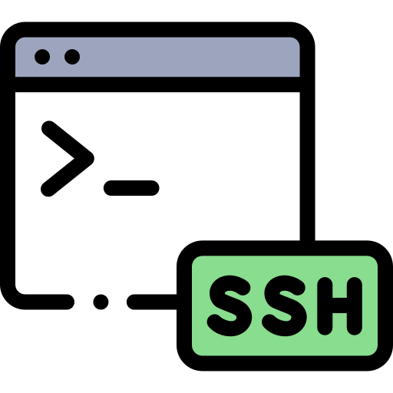
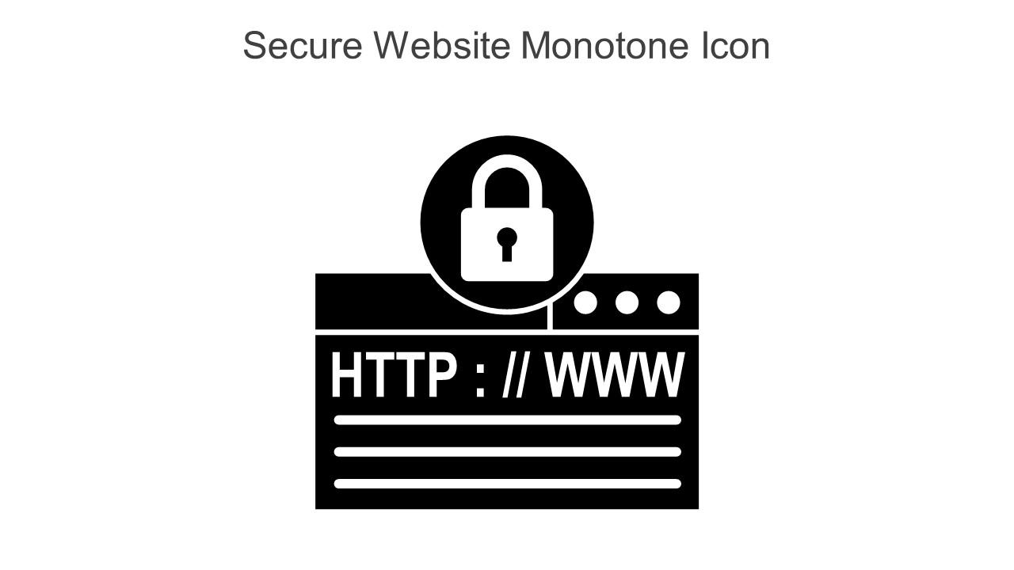
Security Considerations (Part 4)
Web Server:
Allowed HTTP and SSH
Public IP only on Web EC2
Database:
No public access
Only accessible from Web SG (port 3306)
Internal security:
Strict SG rules between Web and DB

Slide 7

Testing & Verification
Verified Web App access via Public IP
Connected via SSH to install Apache
Verified DB is isolated (no internet access)
Tested internal connectivity between Web and DB

Slide 8

Importance of subnet segmentation for security
Use of Security Groups for internal firewalling
CloudFormation makes deployments fast and error-free
How to balance access with protection

Slide 9
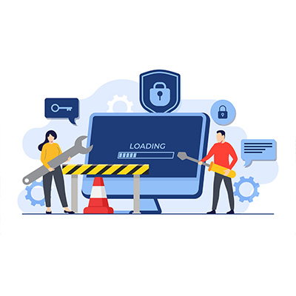
Challenges Faced
Understanding route tables and subnet associations
EC2 key pair issues for SSH access
Testing connectivity between web and DB layers
Debugging CloudFormation YAML errors

Slide 10

Successfully built secure, scalable cloud infrastructure
Ensured public access for web and protected backend database
Learned AWS best practices for real-world cloud environments

Slide 11

Thank You!

